Slide 1
Logistic Regression
DoML Week 3

Slide 2
Gradient Descent Review
What’s a gradient?
How do we update the hypothesis?
What’s a learning rate?
What happens if the learning rate is too big?
How do we know that we’ve reached a minimum?

Slide 3
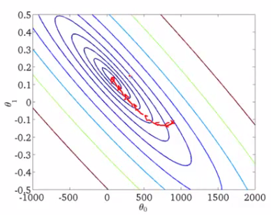
Visualization of Gradient Descent

Slide 4
Classification
Given data points and class labels, finding a way to make yes/no predictions
What should be our measure of accuracy?
Then what do we use as our cost function?
Without regularization for now
Why do we use sigmoid?
How is the prediction calculated?
What’s the form of the gradient?

Slide 5
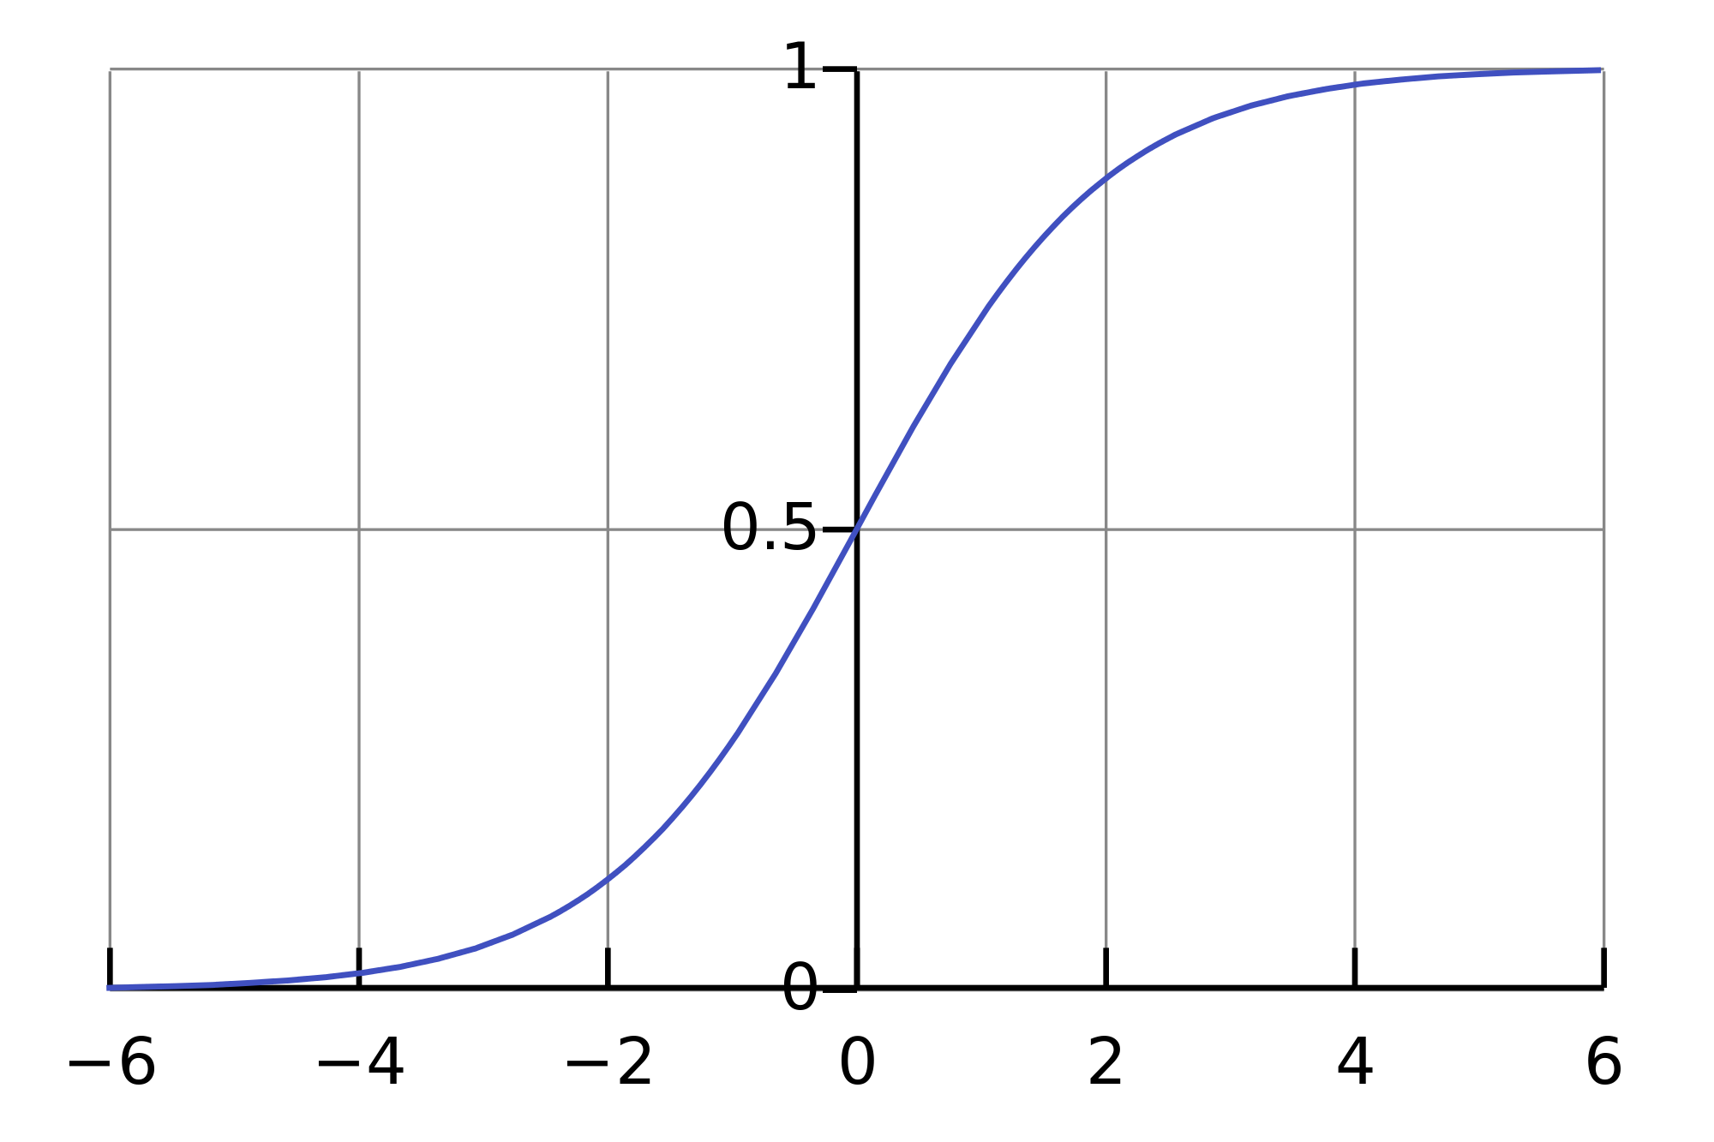
Visualization of Sigmoid

Slide 6
ML Process
Acquire data
Partition it
Hypothesize
Evaluate quality of hypothesis
Optimize hypothesis
Visualize hypothesis and its performance
Assess output
Redesign?

Slide 7
Data Set: University Admissions
Input variables are two exam scores
Output variable is admission
Try a linear function with an intercept term first
How do we add a constant term to our prediction?
We’ll see how well this works
Copy P:\DoML_Week3

Slide 8
Suggested Steps
Build Insight into the problem
Plot the data
Plot the pos and neg points differently
Decide on a form for weights - does it include a constant term? How do you add it?
Pick some weights and then compute the accuracy of your prediction on the data (different from the cost function)
Plot the decision boundary
Then, start the formal process, using given starter code
Partition your data into train and test data
Write the proper cost function and gradient of the cost wrt the parameters
Implement gradient descent
Assess results of your optimization with visualizations, checking gradient at the end of the run, and other diagnostic tools

Slide 9
Feature Engineering, Regularization
Could we have done better if we had a nonlinear separator?
What’s a higher-order projection?
Could it give us a discontinuous decision boundary?
What does regularization do?
How do the cost function and gradient change with regularization?

Slide 10
Data Set: Manufacturing Quality Control
Two measurements of quality of a microchip
High quality have measurements near zero
Labels from human quality assessor
Can the quality control process be fully automated?

